Slide 1
Java 8 New Features

Slide 2
Agenda
Lambda Expressions
Introduction to Lambdas
Default Methods in Interfaces
Method References

Slide 3
Agenda
Collections & Lambdas
External vs. Internal Iteration
Enhancements on Collections
Streams
Filter-Map-Reduce
Lambda Pitfalls

Slide 4
Agenda
Java Date & Time API
Date Processing before JSR-310
Overview on New Classes

Slide 5
Agenda
Further Changes in JDK 1.8
Extensions of Interface Comparator<T>
Class Optional<T>
Parallel Array Operations
Extensions of Interface Map<K,V>
Extensions of NIO and Class Files
Concurrency Enhancements
Nashorn JavaScript Engine

Slide 6
Agenda
Further Changes in JDK 1.8
No Permanent Generation
Reflection Enhancements
Base64 Encodings
Changes with Annotations

Slide 7
Exercise 1
Write a class Calculator whose constructor can be hand over the operation which should be performed when the method
int calculate(int number1, int number2)
is called.

Slide 8
Agenda
Lambda Expressions
Introduction to Lambdas
Default Methods in Interfaces
Method References

Slide 9
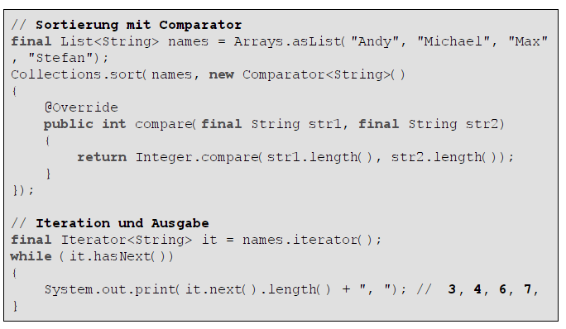
Example Sorting
// sorting using comparators
// iteration and output
How can you improve this?

Slide 10
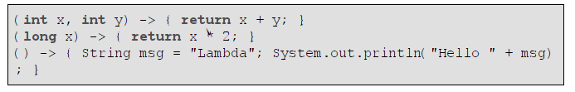
Introduction to Lambdas
A Lambda is a container of source code similar to a method, but without name and without explicit return type and exceptions.
( parameters ) -> { expression or statements }

Slide 11
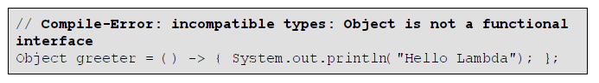
Introduction to Lambdas
Lambas cannot be directly assigned to variables of type Object.
They can be assigned to functional interface types only.

Slide 12
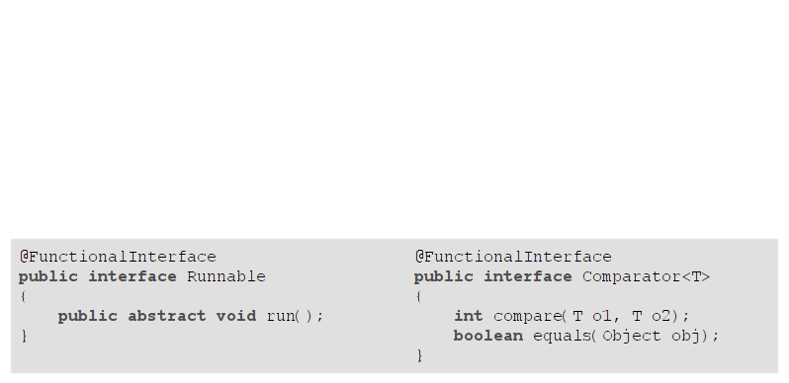
Functional Interfaces / SAM Types
A functional interface is a new kind of Java interface. It defines exactly one abstract method.
You may annotate a functional interface with @FunctionalInterface
annotation, but it is not required.
Only the term "functional interface" is new. Examples of functionals
interfaces in Java 7 and before:
Runnable, Callable, Comparator, FileFilter, FilenameFilter, ActionListener, …
???

Slide 13
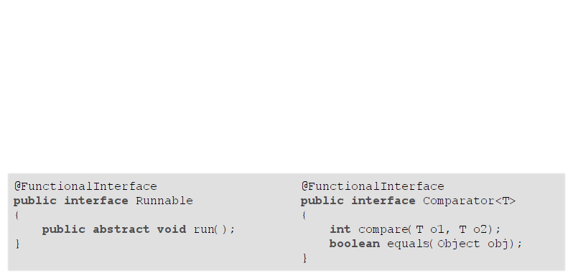
Functional Interfaces / SAM Types
Functional interfaces may define methods of class Object too.
!!!

Slide 14
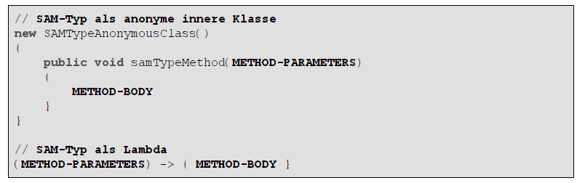
Functional Interfaces / SAM Types
// SAM (Single Abstract Method) type implemented as anonymous inner class

Slide 15
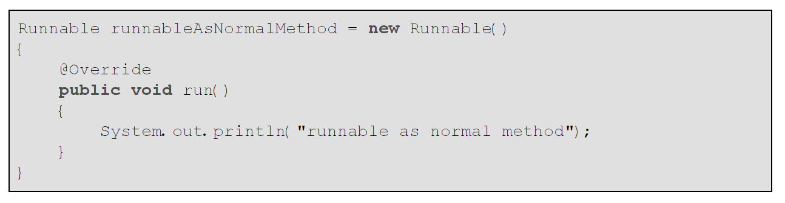
Functional Interfaces / SAM Types

Slide 16
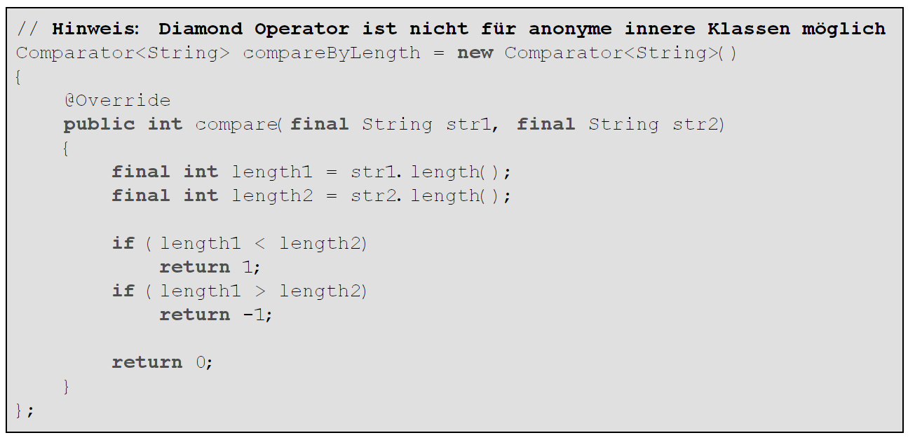
Functional Interfaces / SAM Types
// diamond operator not allowed for anonymous inner classes

Slide 17
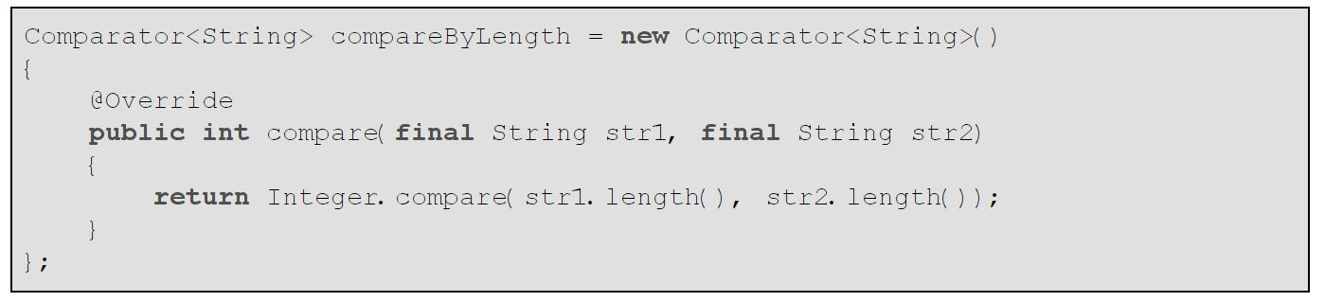
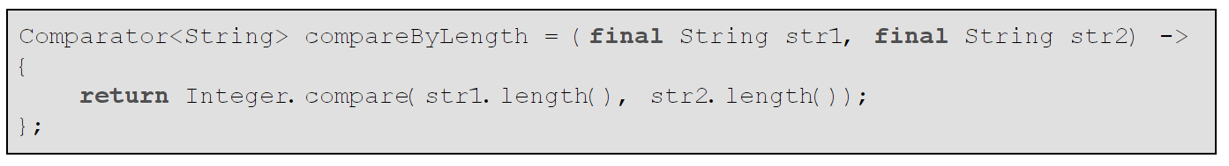
Functional Interfaces / SAM Types

Slide 18
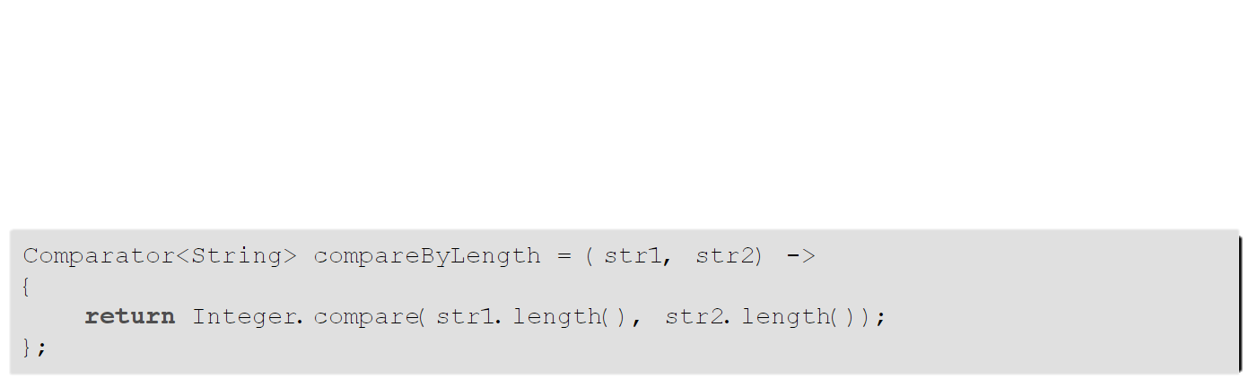
Functional Interfaces / SAM Types
Type inference is the Java compiler's ability to look at each method invocation and corresponding declaration to determine the type argument (or arguments) that make the invocation applicable. The inference algorithm determines the types of the arguments and, if available, the type of the result. Finally, the inference algorithm tries to find the most specific type that works with all of the arguments.
Can be shortened to:

Slide 19
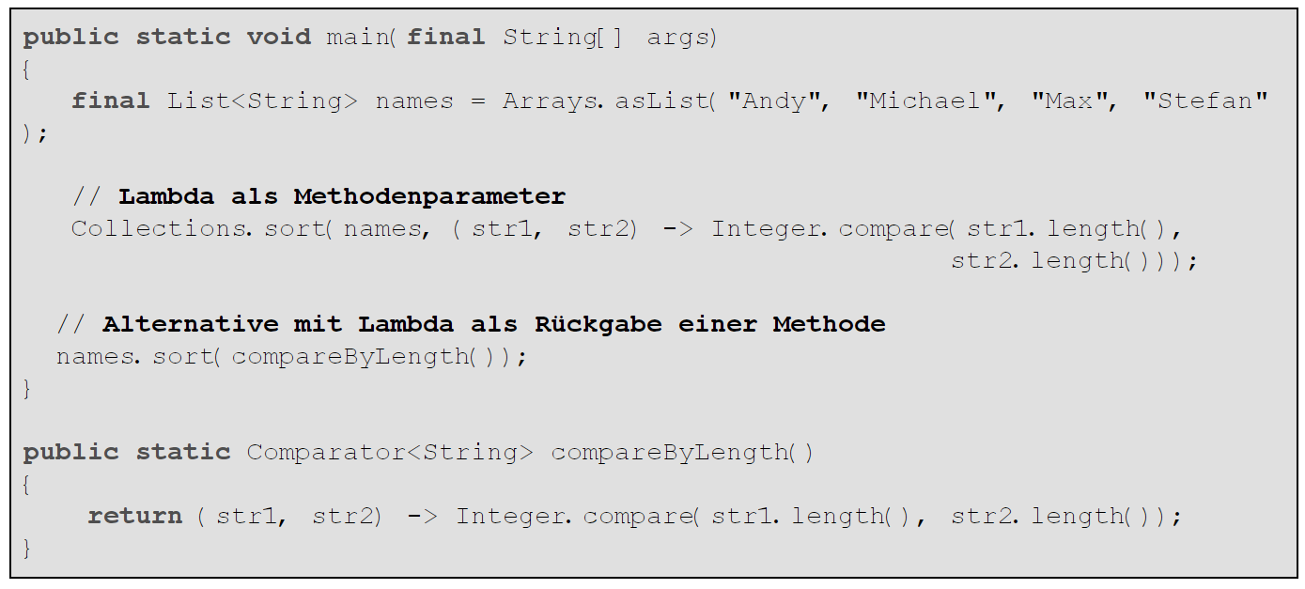
Functional Interfaces / SAM Types
// Lambda as method parameter
// Lambda returned by method

Slide 20
Functional Interfaces / SAM Types
this in Lambdas
Lambdas do not have a relationship to Object
this references the outer object in which the Lambda is defined
Note: in anonymous inner classes this references the inner object

Slide 21
Functional Interfaces / SAM Types
Access variables:
Lambdas can access any instance variables of the outer object. It also can access local variables of the method they are defined in.
Local variables must be "effectively" final when accessed by the Lambda expression (will be checked by compiler).

Slide 22
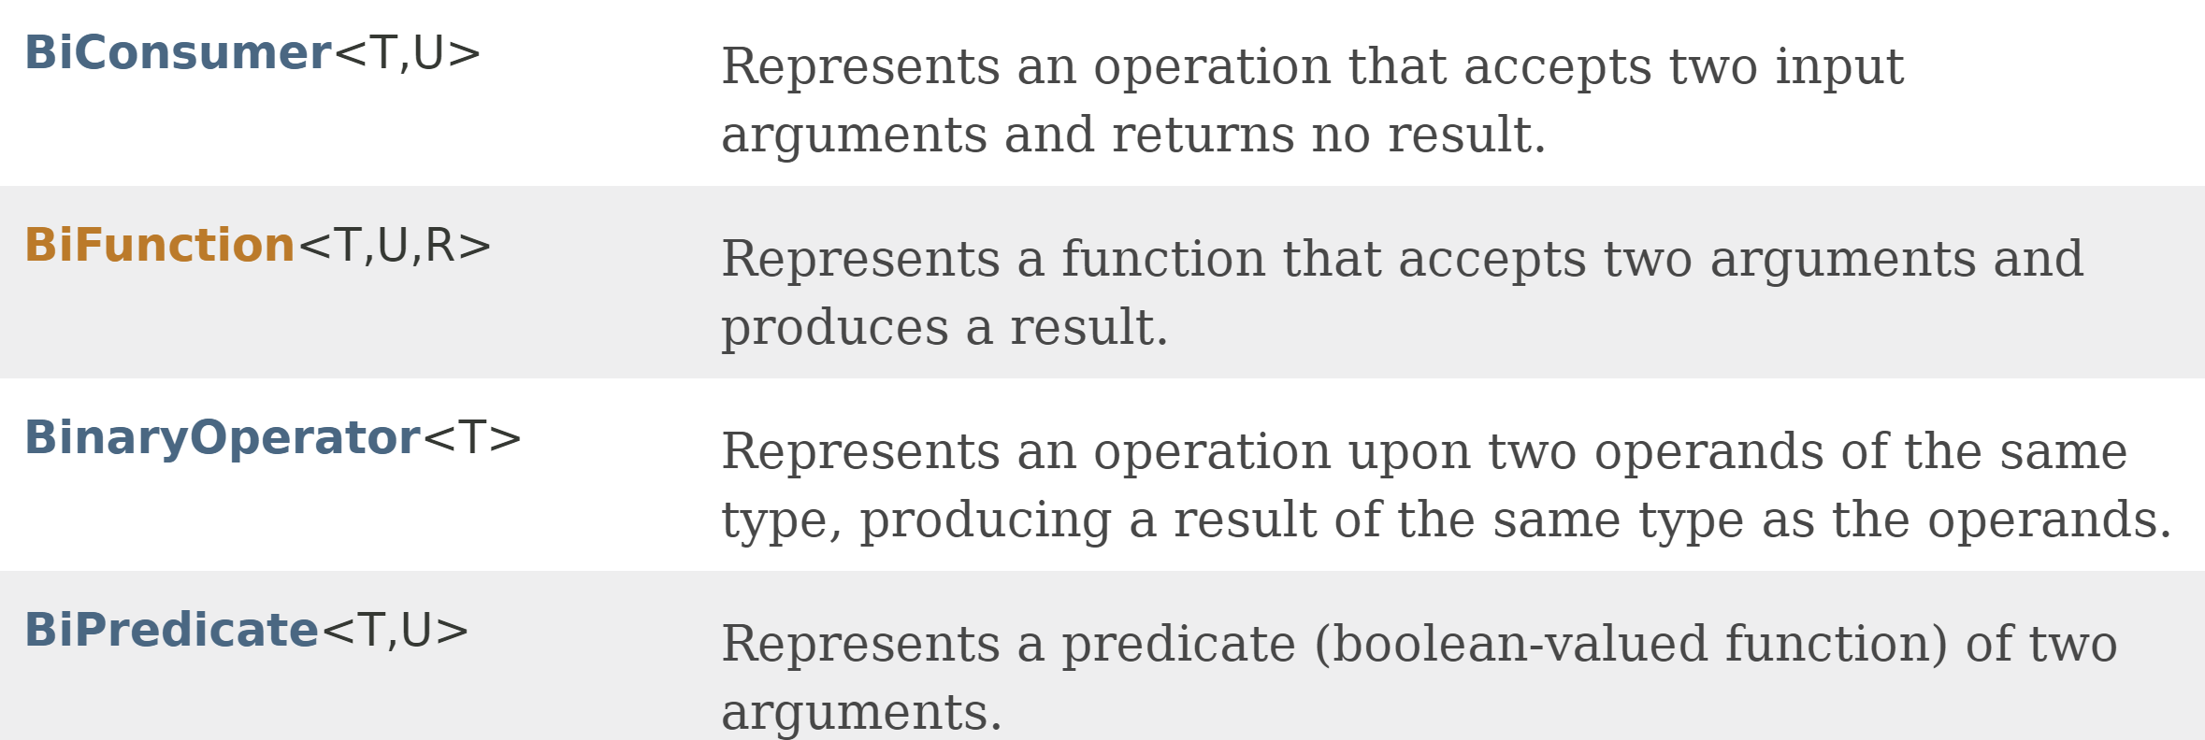
Predefined Functional Interfaces

Slide 23
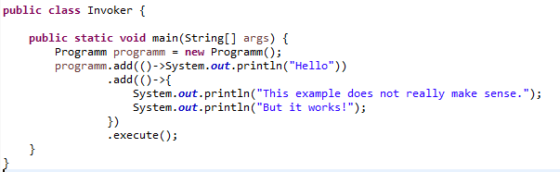
Exercise 2
Write a class Programm so that the following code can be compiled and executed:

Slide 24
Agenda
Lambda Expressions
Introduction to Lambdas
Default Methods in Interfaces
Method References

Slide 25
Default Methods in Interfaces
Up to JDK 1.7 interfaces are a kind of abstract classes which only can have abstract methods.
Starting with JDK 1.8 Interfaces may also define concrete "default" methods.
A class which implements such an interface also inherits these method implementations, which – of course – can be overridden.

Slide 26
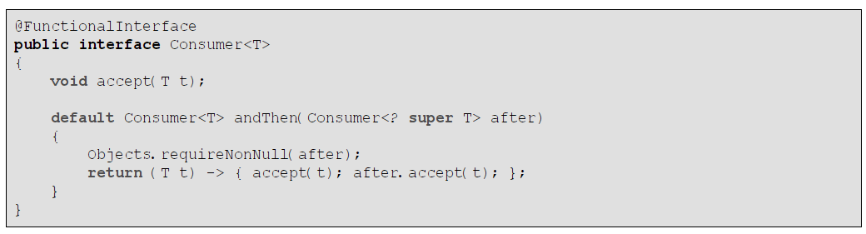
Default Methods in Interfaces

Slide 27
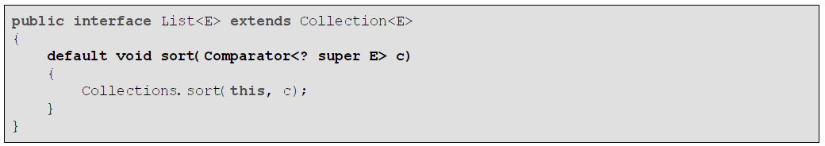
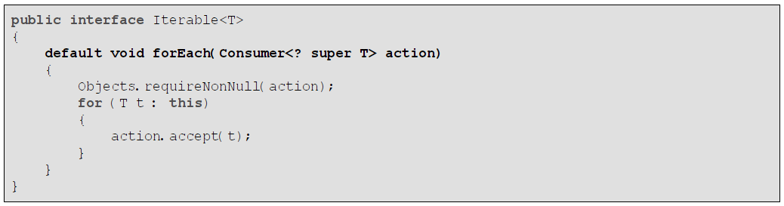
Default Methods in Interfaces
JDK examples

Slide 28
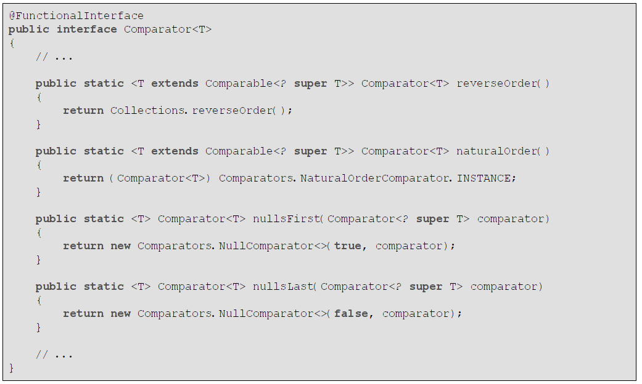
Static Methods in Interfaces
Starting with JDK 1.8 interfaces also can have static methods:

Slide 29
Exercise 3
Analyse the method Function.andThen() in the Java 8 API documentation.
What is Function? What is andThen()?

Slide 30
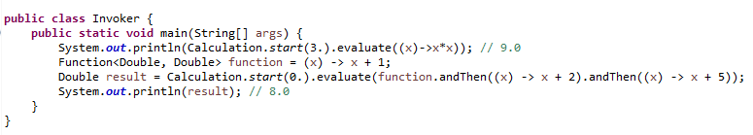
Exercise 4
Write a class Calculation so that the following code compiles and executes:

Slide 31
Agenda
Lambda Expressions
Introduction to Lambdas
Default Methods in Interfaces
Method References

Slide 32
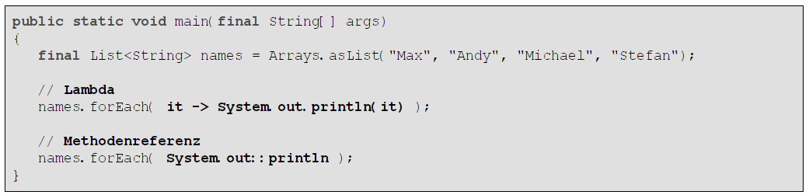
Method References
Method references follow the syntax:
Class::method-name
Example:
Passing of parameters is done automatically by using the order of the Lambda
and the methods parameters.

Slide 33
Method References
Further examples:
Reference To … | Method Reference | Lambda
static method | String::valueOf | obj -> String.valueOf(obj)
instance method of a type | Object::toString String::compareTo | obj -> obj.toString() (str1,str2)->str1.compareTo(str2)
instance method of an object | person::getName | () -> person.getName()
constructor | ArrayList::new | () -> new ArrayList<>()
A Lambda that only does just one method call can be replaced by a method reference.

Slide 34
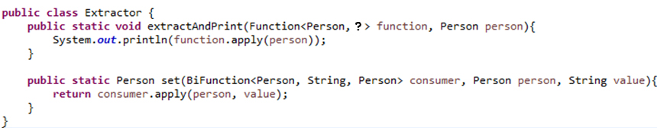
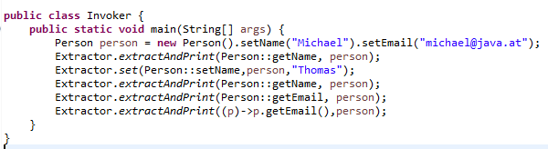
Exercise 5
Given the following classes:
Write a class Person so that the code compiles and executes.

Slide 35
Agenda
Collections & Lambdas
External vs. Internal Iteration
Enhancements on Collections
Streams
Filter-Map-Reduce
Lambda Pitfalls

Slide 36
External vs. Internal Iteration
External iteration: loop is controlled by caller which accesses the collection using an index or iterator
Internal iteration: loop is controlled by collection itself

Slide 37
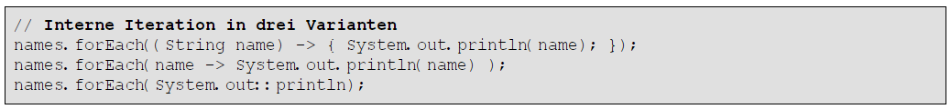
Internal Iteration in JDK 1.8
New methods in interface Collection:
Examples:
// internal iteration in 3 variants

Slide 38
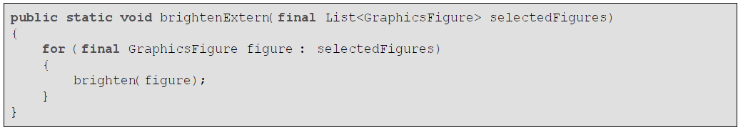
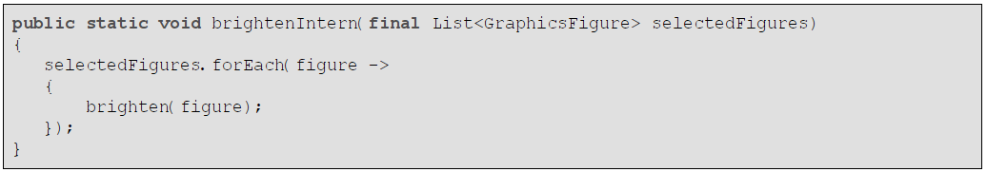
External vs. Internal Iteration
External iteration:
Internal iteration:

Slide 39
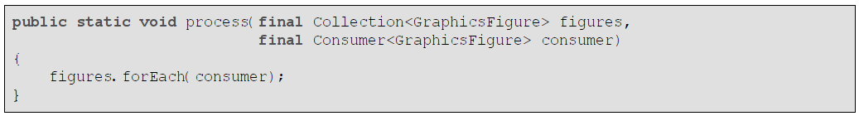
External vs. Internal Iteration
Another example:
Or:

Slide 40
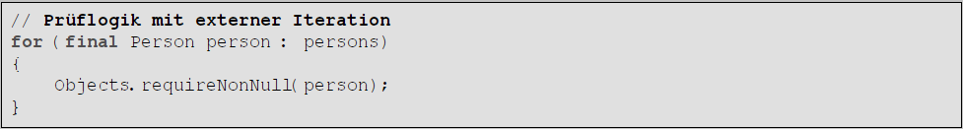
External vs. Internal Iteration
Another example:

Slide 41
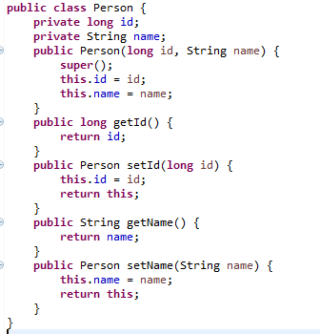
Exercise 6
Given the following class
Construct a list of persons. Use the list to construct a map using the person's id as the key and person itself as the value. Solve this exercise by using internal and external iteration.

Slide 42
Agenda
Collections & Lambdas
External vs. internal Iteration
Enhancements on Collections
Streams
Filter-Map-Reduce
Lambda Pitfalls

Slide 43
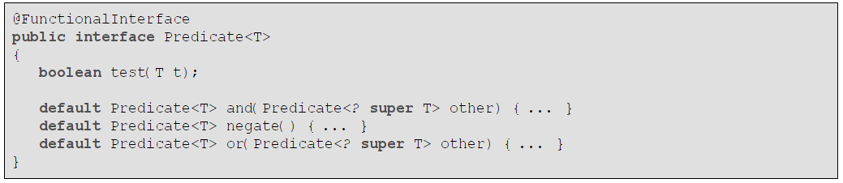
Interface Predicate<T>

Slide 44
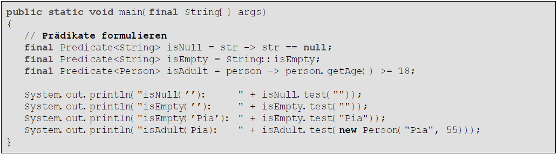
Interface Predicate<T>
Example:
// define predicates

Slide 45
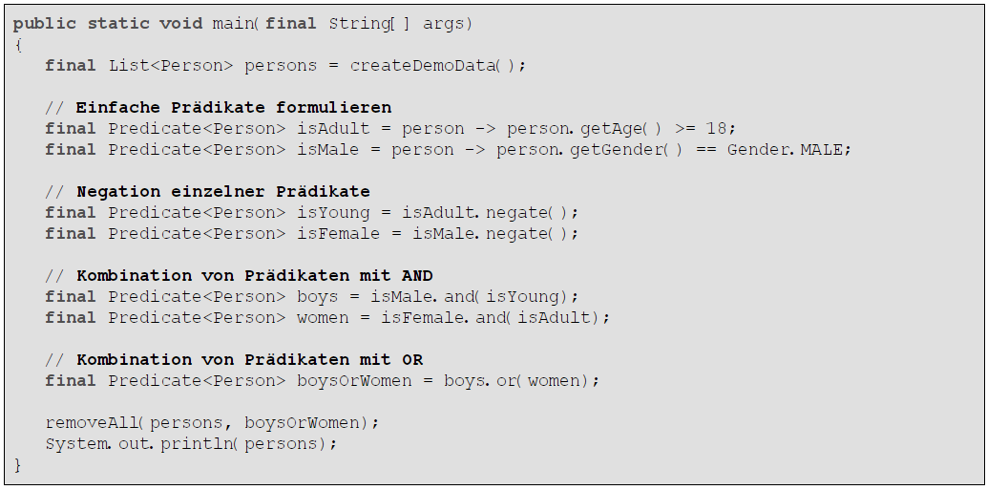
Interface Predicate<T>
Examples for using negate, and, or:
// simple predicates
// negation of predicates
// combining predicates using AND
// combining predicates using OR

Slide 46
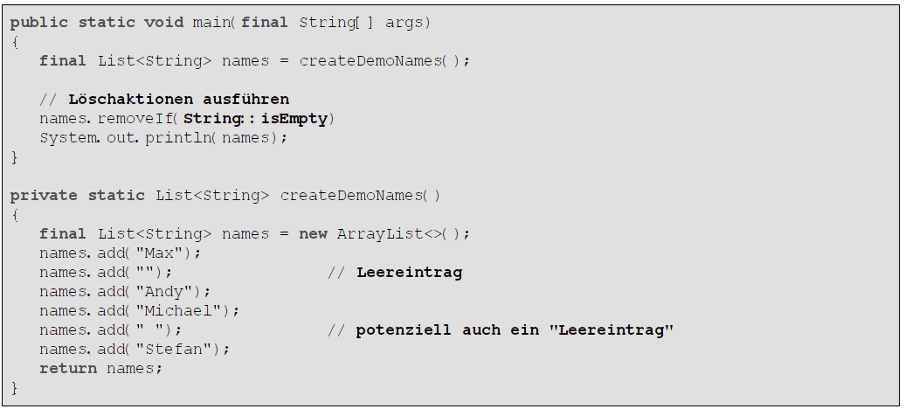
removeIf Method in Collection
Example:
// remove
// empty element
// whitespace element

Slide 47
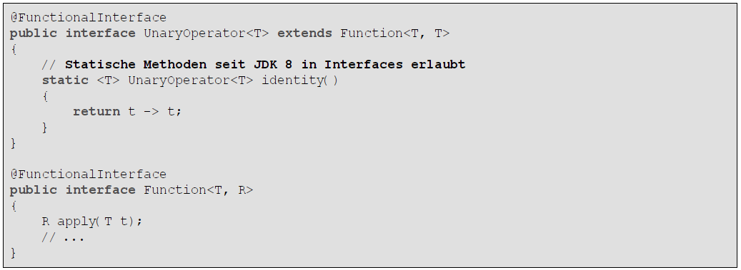
Interface Function<T,R> and UnaryOperator<T>
// interfaces may have static methods

Slide 48
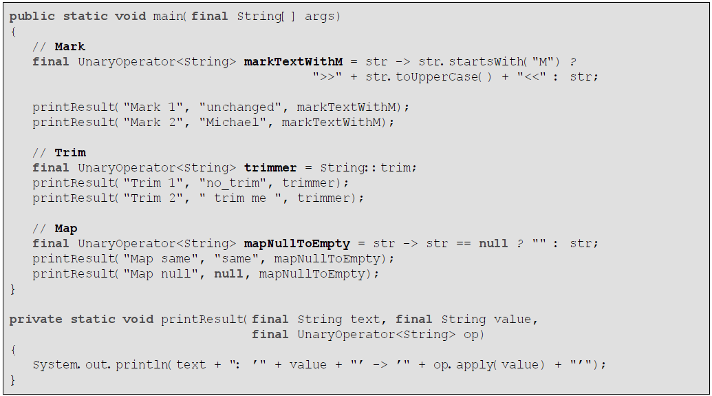
Interface Function<T,R> and UnaryOperator<T>

Slide 49
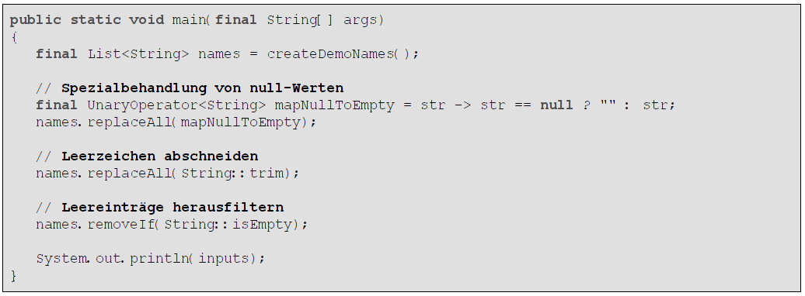
replaceAll Method in List
Example:
// handling null values
// trim whitespace
// remove empty values

Slide 50
Exercise 7
Generate a list of 1000 random numbers between 0 and 100.
Remove all numbers which are even and larger than 50.
Use the functional interface Predicate.

Slide 51
Agenda
Collections & Lambdas
External vs. internal Iteration
Enhancements on Collections
Streams
Filter-Map-Reduce
Lambda Pitfalls

Slide 52
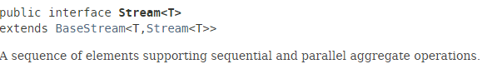
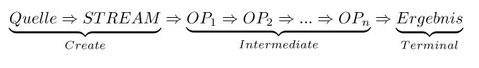
Streams
java.util.stream.Stream != java.io.*Stream
Example:
Source
Result

Slide 53
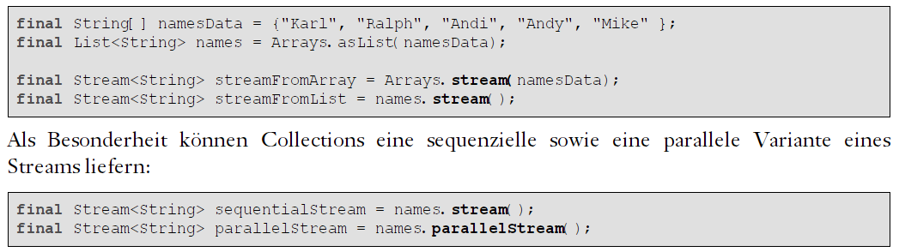
Construction of Streams
Streams can also be executed in parallel (using multiple threads):

Slide 54
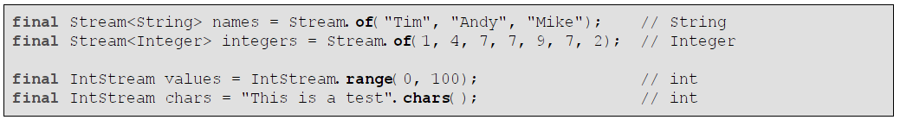
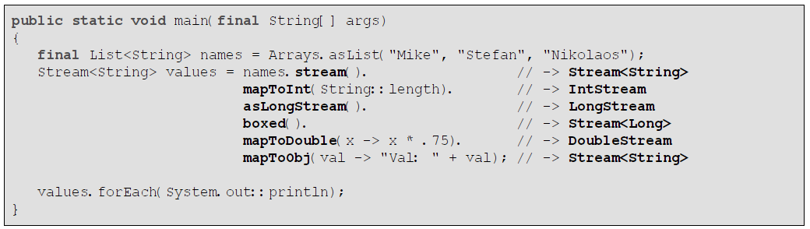
Construction of Streams
Streams of primitives
Transformation to Stream<Long>

Slide 55
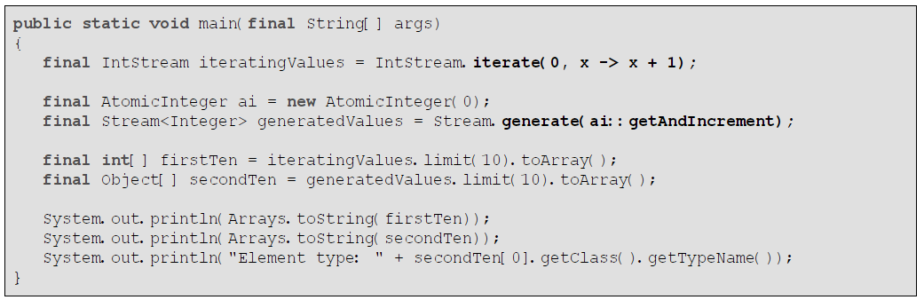
Infinite Streams

Slide 56
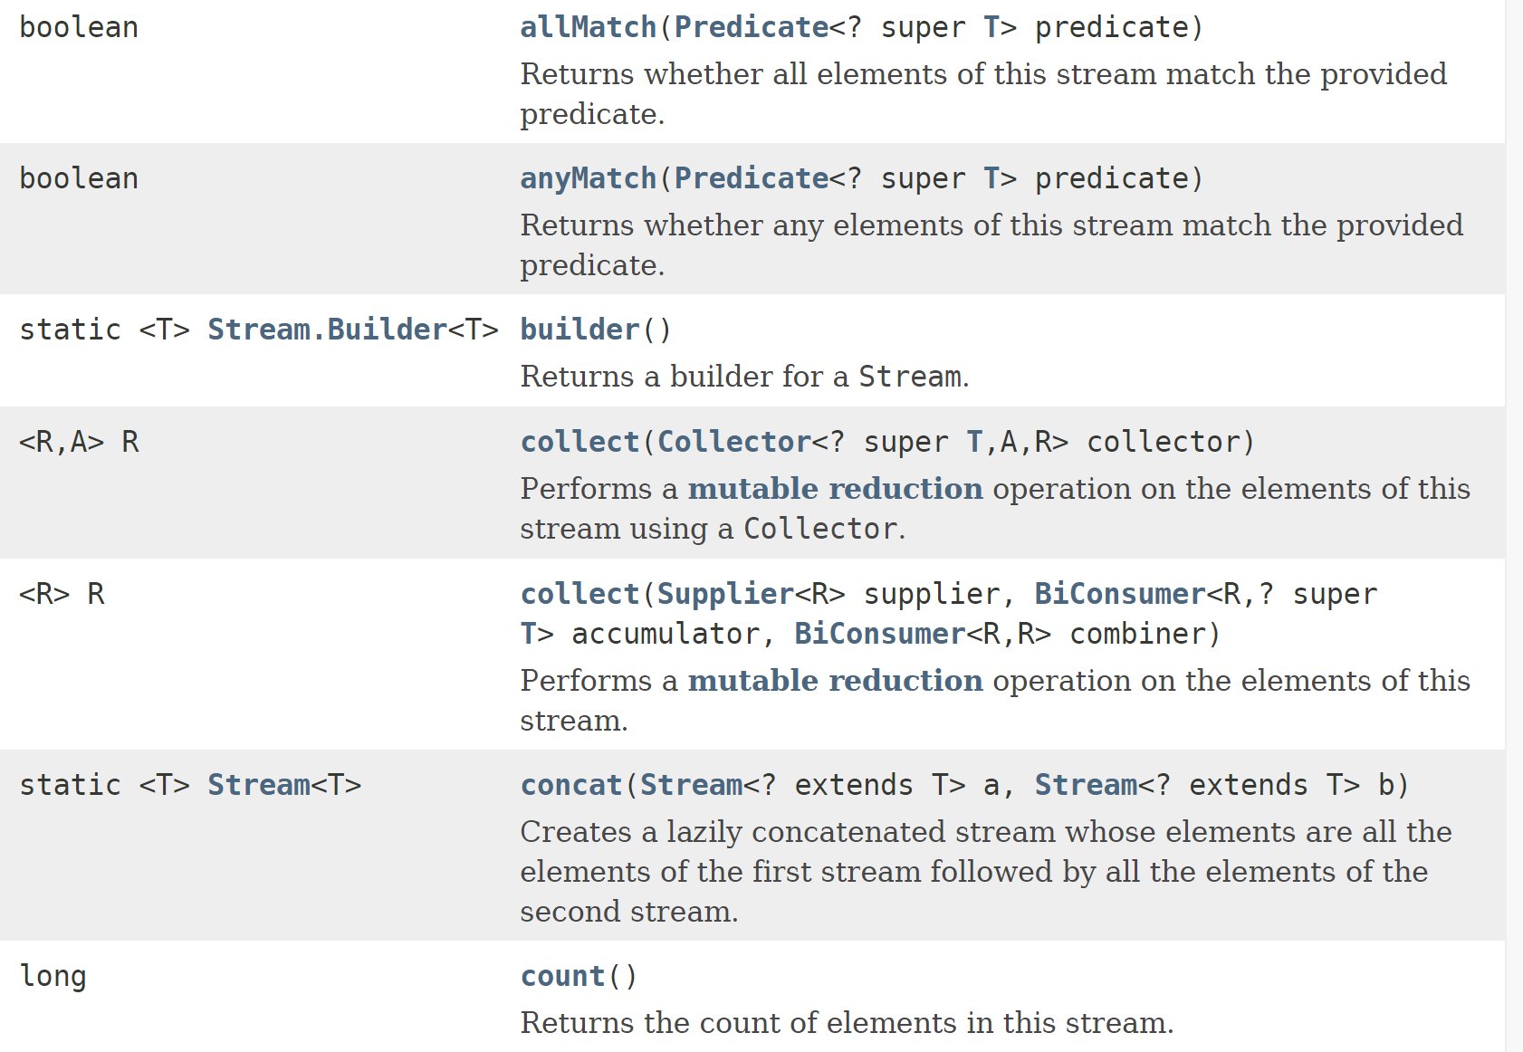
Source
Result

Slide 57
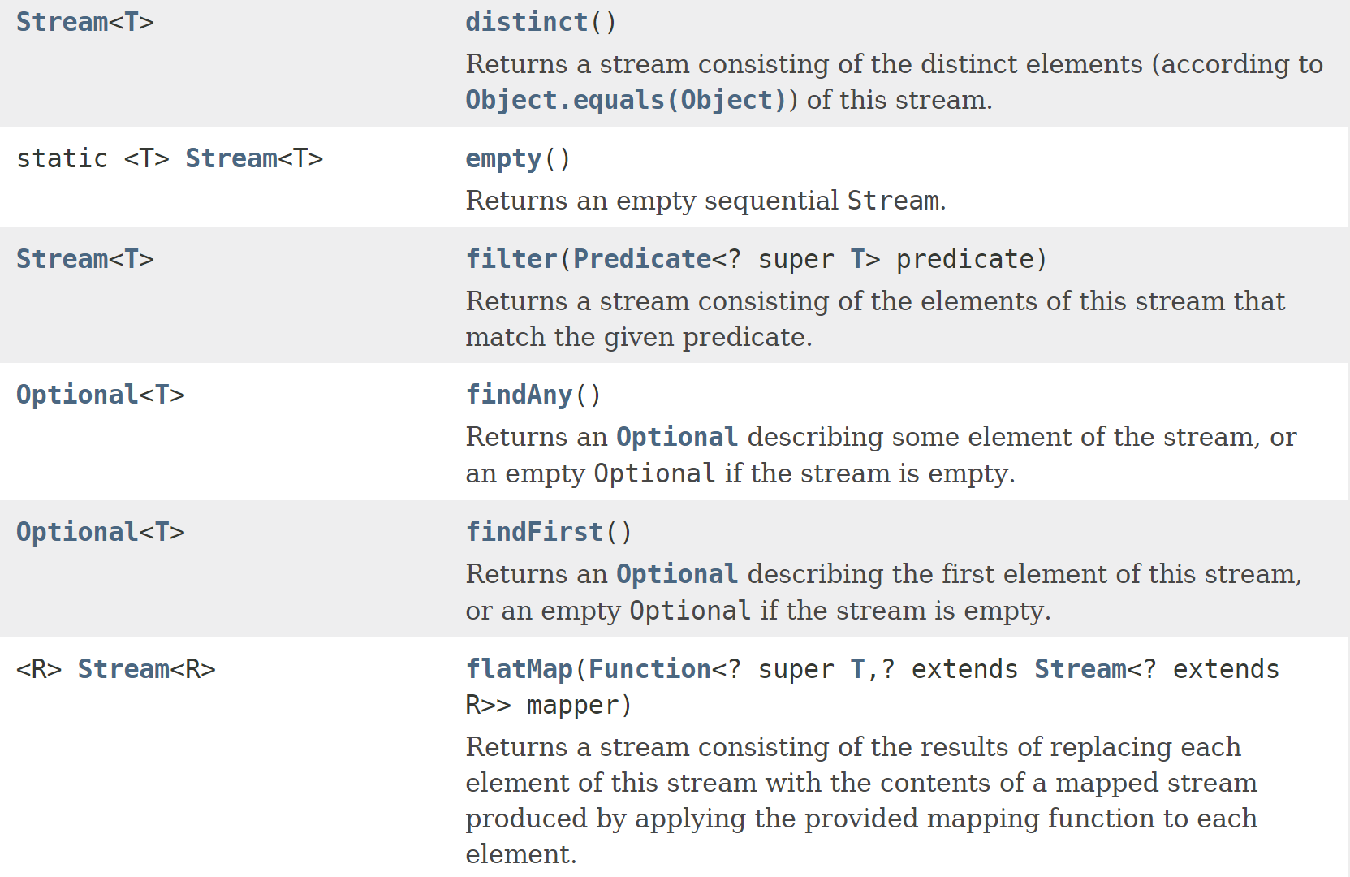
Source
Result

Slide 58
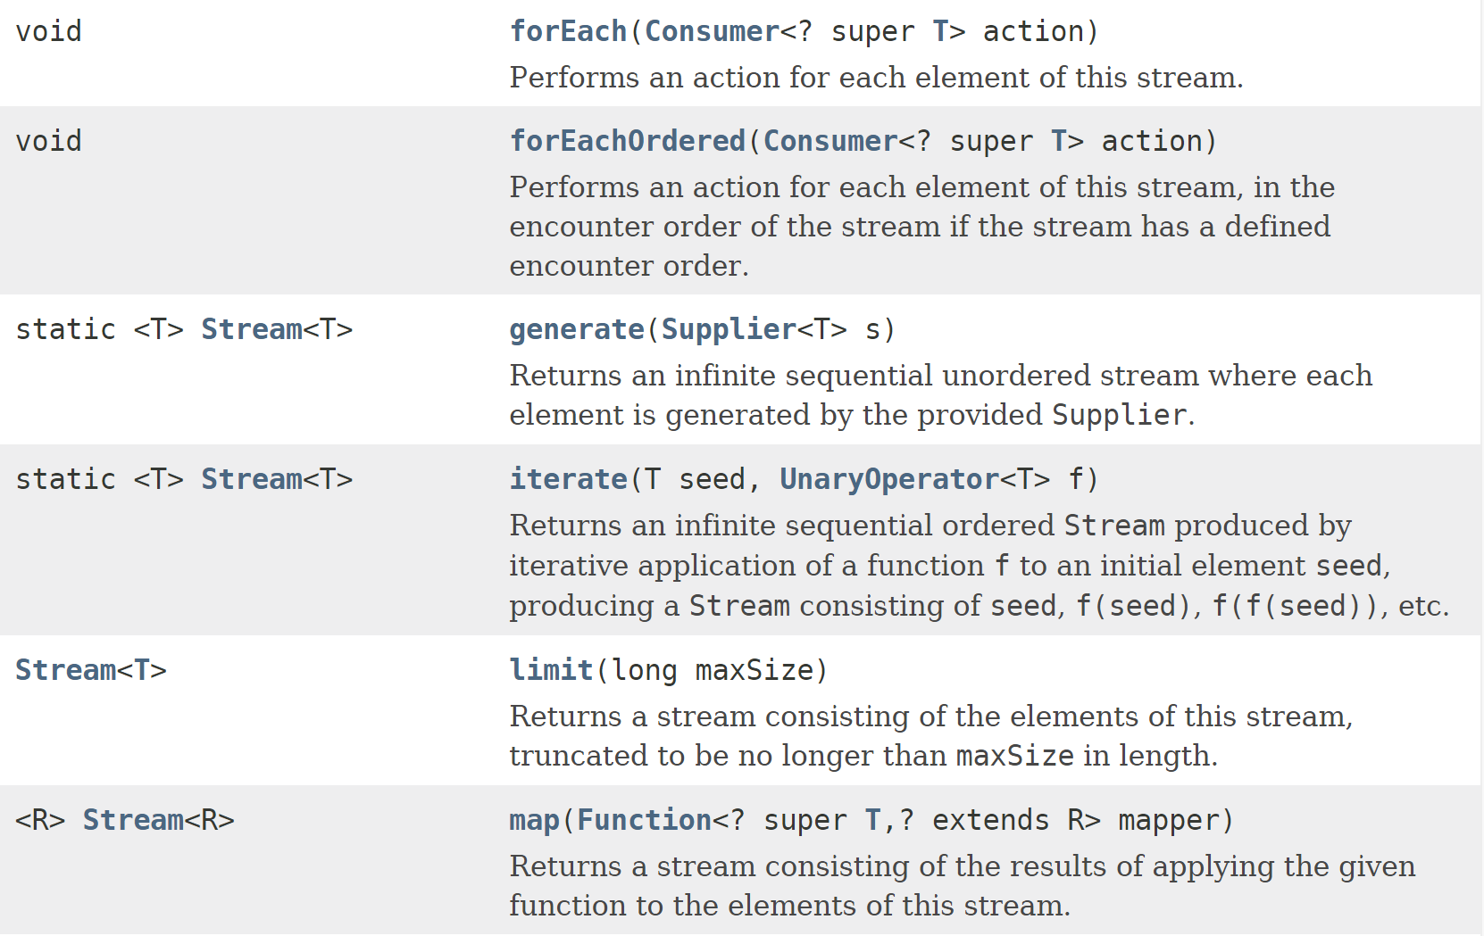
Source
Result

Slide 59
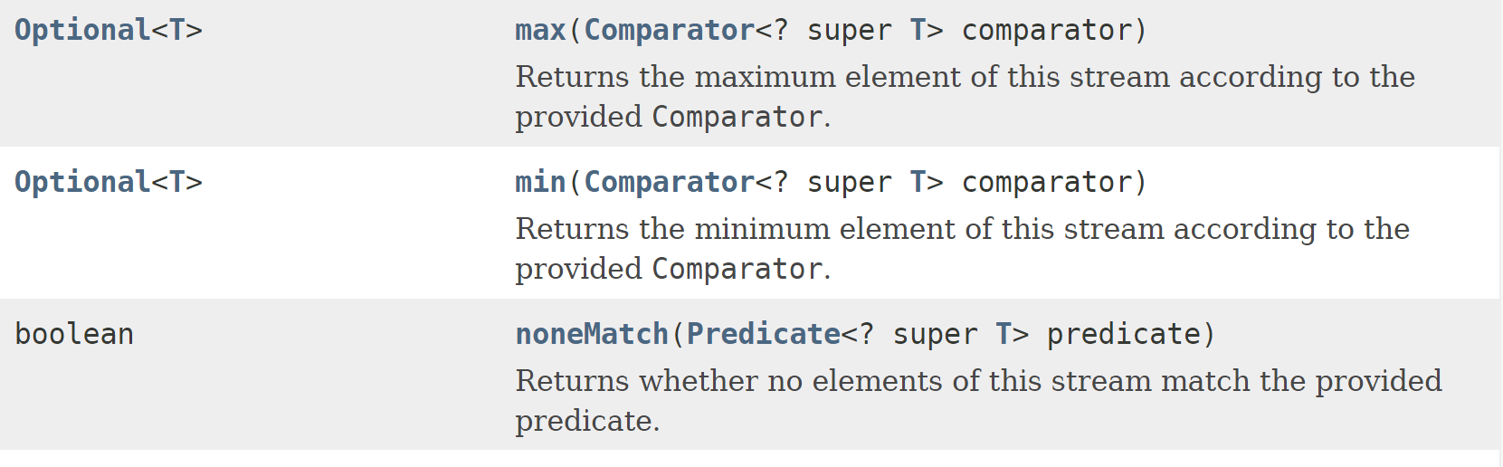
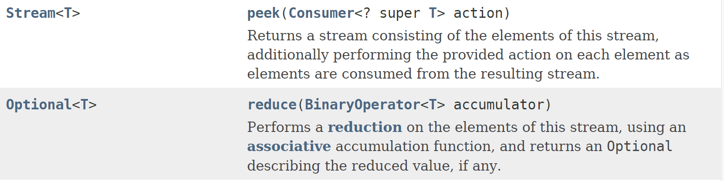
Source
Result

Slide 60
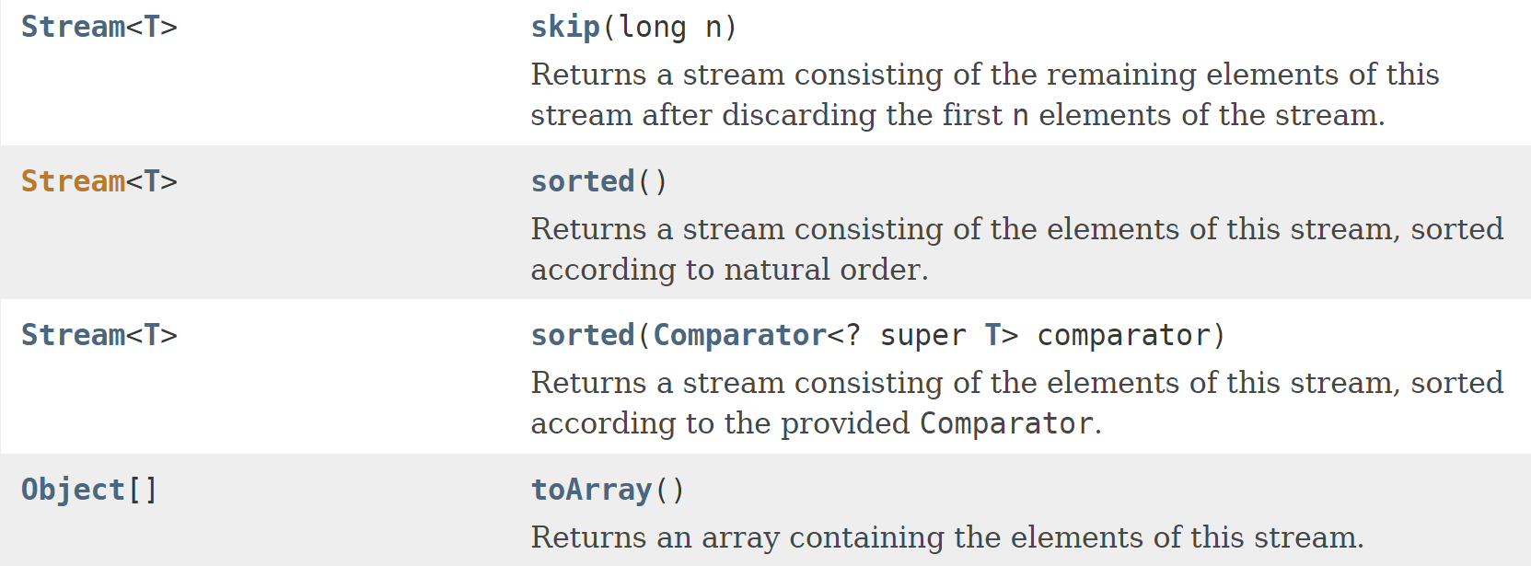
Source
Result

Slide 61
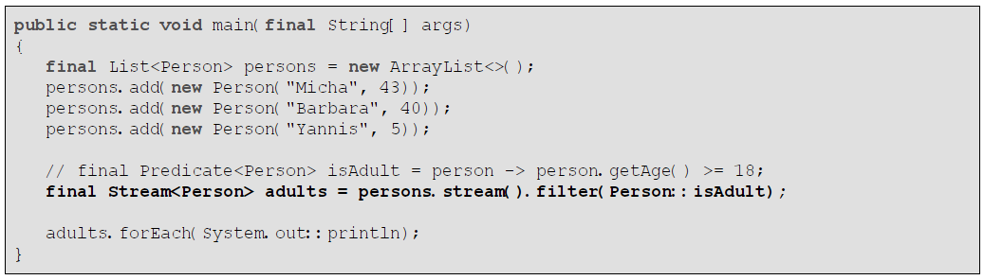
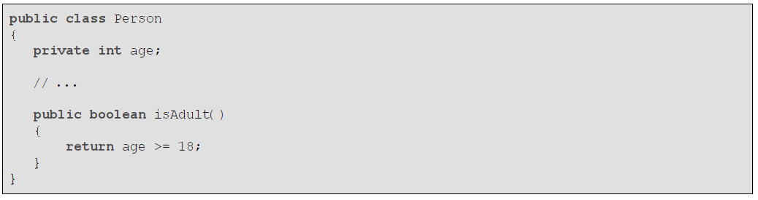
filter

Slide 62
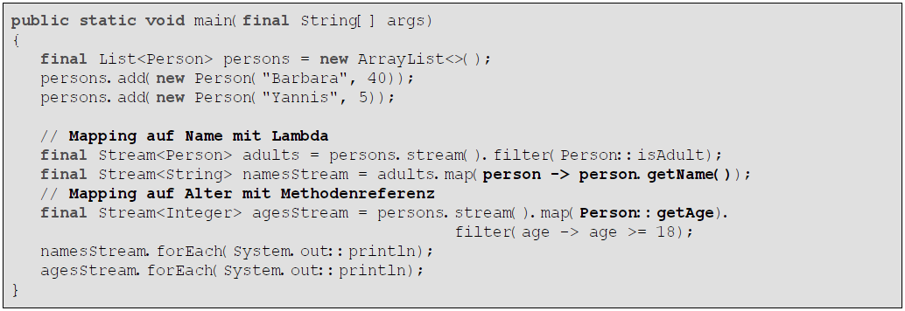
map
// mapping Person to String
// mapping Person to Integer

Slide 63

flatMap
Task: create a stream of words out of a stream of sentences:
Nested streams:
Nested streams can be flattened using flatMap:

Slide 64

// JDK 1.8: read all lines of a file
// create a stream out of words
// predicate for identifying short words
// predicate for ignorable words
// filtering using predicates

Slide 65

peek
intermediate operation that reads and processes the current value
// print all adults
// filter all words

Slide 66

peek
// trigger execution

Slide 67

distinct and sorted

Slide 68

distinct and sorted

Slide 69
limit and skip

Slide 70
forEach

Slide 71

toArray
// random numbers between 0 and 100

Slide 72

count,sum,min,max,average
// persons whose names start with a "T"
// calculate sum
// calculate average age

Slide 73


allMatch, anyMatch, noneMatch

Slide 74

findFirst, findAny

Slide 75

anyMatch, findFirst
// define name filter

Slide 76


Collectors: joining, groupingBy, partitioningBy

Slide 77

Collectors: joining, groupingBy, partitioningBy

Slide 78


Parallel Processing of Stream
Switching from parallel to sequential execution:
Following code might produce unsorted output:
This can be solved as follows:
Parallel streams use a shared ForkJoin pool. The number of threads corresponds with Runtime.availableProcessors().

Slide 79
Exercise 8
Write the following classes:
Person (id, firstName, lastName, birthDate, activated, address)
Address (id, street, postcode, city, countryCode)
Create a list containing several persons and solve the following tasks using streams:
Return the full name of all persons from Vienna in form of a list.
Print all persons who are activated and come from Austria to the standard console.
Calculate the average age of all persons from Germany.
Is there a person in the list who is over 50 years old and from Switzerland?
Are the addresses of all persons valid (i. e. all fields are not null and not empty)?

Slide 80
Exercise 9
Construct a list with 100.000 persons. Set one of the persons names to John Doe.
Search the list both sequential and parallel for this person and extract the birth date.
Compare the execution times.

Slide 81
Agenda
Collections & Lambdas
External vs. internal Iteration
Enhancements on Collections
Streams
Filter-Map-Reduce
Lambda Pitfalls

Slide 82

Filter-Map-Reduce

Slide 83

Filter-Map-Reduce

Slide 84



Filter-Map-Reduce

Slide 85

Filter-Map-Reduce
For concatenating an array or list of strings there exists a new method join() in class String:

Slide 86

Filter-Map-Reduce
Another example:

Slide 87
Exercise 10
Create a list containing 100.000 random numbers between 1 and 1000.
Based on this list create a comma separated string that contains all numbers <10, sorted, and duplicates eliminated.
During processing calculate the sum of the filtered numbers.
Implement the same logic using loops and compare the execution times.

Slide 88
Agenda
Collections & Lambdas
External vs. internal Iteration
Enhancements on Collections
Streams
Filter-Map-Reduce
Lambda Pitfalls

Slide 89


Imperative Programming Using Streams
Imperative Solution:
1:1 translation of imperative solution (bad approach):
Exercise: Implement a better solution using streams?

Slide 90
Agenda
Java Date & Time API
Date Processing before JSR-310
Overview on New Classes

Slide 91

Legacy Date Processing
What is the result?

Slide 92
Legacy Date Processing
What is the result?

Slide 93

Legacy Date Processing
// difference of 1 hour 10 minutes 20 seconds
// parsing date strings
// mapping to age
// setting timezone

Slide 94
Agenda
Java Date & Time API
Date Processing before JSR-310
Overview on New Classes

Slide 95
java.time.Instant
Equivalent to class Date
Nanos since 01.01.1970 00:00:00 UTC
Represents a timestamp in timezone UTC
Internally saved as seconds (long) + nanos (int)

Slide 96

java.time.Instant
// leaving now, 5 hours travel time
// delay calculated 2 different ways

Slide 97



java.time.Instant

Slide 98


java.time.Instant
// leaving now, 5 hours travel time
// calculating difference

Slide 99
java.time.LocalDate java.time.LocalTime java.time.LocalDateTime
LocalDate … date without time
LocalTime … time without date
LocalDateTime … date and time
LocalDateTime.now() is the time in the machine's timezone
Timezone is not stored in the object
To convert LocalDateTime to Instant you have to pass a timezone as a parameter

Slide 100

java.time.LocalDate java.time.LocalTime java.time.LocalDateTime

Slide 101



java.time.LocalDate java.time.LocalTime java.time.LocalDateTime

Slide 102



Slide 103

java.time.DayOfWeek java.time.Month
Enums for days of week and months

Slide 104


java.time.DayOfWeek java.time.Month

Slide 105
java.time.YearMonth java.time.MonthDay java.time.Year
YearMonth … contains year and month
MonthDay … contains month and day
Year … just year

Slide 106

java.time.YearMonth java.time.MonthDay java.time.Year

Slide 107



java.time.YearMonth java.time.MonthDay java.time.Year

Slide 108


java.time.Duration
Represents a duration (internally saved as seconds + nanos)

Slide 109

java.time.Duration
// instantiation
// calculation

Slide 110


java.time.Duration
// instantiation
// calculate duration
// using duration for further calculations

Slide 111
java.time.Period
Represents a conceptual period of time
What is the difference to Duration?
Duration … time in seconds or below
Period … time in days, months, years

Slide 112


java.time.Period

Slide 113

java.time.Period

Slide 114

java.time.ZonedDateTime
Represents a date and time in a specific timezone

Slide 115


java.time.ZonedDateTime
// current time incl. timezone
// changing time (new object)
// changing date (new object)
// using constants for month

Slide 116
java.time.DateTimeFormatter
Formats TemporalAccessors
Temporal accessors are: DayOfWeek, Instant, LocalDate, LocalDateTime, LocalTime, Month, Year, YearMonth, ZonedTimeDate …

Slide 117
java.time.DateTimeFormatter
Most temporal accessors implement the methods:
Examples: LocalDate, LocalDateTime, LocalTime, MonthDay, Year, YearMonth, ZonedDateTime

Slide 118

java.time.DateTimeFormatter

Slide 119



Slide 120

Interoperability
Conversion methods:

Slide 121

Interoperability
// calculations based on Date
// calculations based on Calendar

Slide 122
Exercise 11
Given the following method: public static LocalDate getEasterSunday(int year)
Easter Monday: Easter Sunday + 1 day
Ascension Day: Easter Sunday + 39 days
Whit Monday: Easter Sunday + 50 days
Corpus Christi: Easters Sunday + 60 days
Further holidays: 01.01., 06.01., 01.05., 15.08., 26.10., 01.11., 08.12., 24.12. (½), 25.12., 26.12.,31.12. (½)

Slide 123
Exercise 11
Implement a method isHoliday() which takes a date and returns true if the day is a holiday, otherwise false.
Implement a method isWorkingDay() which takes a date and returns true for a day that is no holidays, Saturday or Sunday.
Implement a method that prints out all holidays of a given year.

Slide 124
Agenda
Further Changes in JDK 1.8
Extensions of Interface Comparator<T>
Class Optional<T>
Parallel Array Operations
Extensions of Interface Map<K,V>
Extensions of NIO and Class Files
Concurrency Enhancements
Nashorn JavaScript Engine

Slide 125

Extensions of Comparator<T>
Define comparators using Lambdas:
Define comparators using factory method comparing:

Slide 126

Extensions of Comparator<T>
Cascading comparators:
Comparing primitives:

Slide 127

Extensions of Comparator<T>
// ascending
// descending
// ascending

Slide 128
Extensions of Comparator<T>
To make a comparator robust, it must be able to handle null values.
// using Comparator.comparing() can lead to NullPointerExcetpions
Solution: decorate your key extracting comparator with a null handling comparator

Slide 129

Extensions of Comparator<T>
Further examples:
// null-safe comparators as decorators

Slide 130
Agenda
Further Changes in JDK 1.8
Extensions of Interface Comparator<T>
Class Optional<T>
Parallel Array Operations
Extensions of Interface Map<K,V>
Extensions of NIO and Class Files
Concurrency Enhancements
Nashorn JavaScript Engine

Slide 131
Optional<T>
Optional is a Wrapper around return values, which enables to return empty objects without using null values.
helps to prevent NullPointerExceptions
Optional<T> is an implementation of the Null Object Pattern.

Slide 132


Optional<T>
// calculate minimum and maximum
// print minimum and maximum
// is there a value?
// getting the value
// factory methods

Slide 133

Optional<T>
Handling alternatives with Optional<T>:
// do something if there is a value
// if present return the value or alternatively return a default
// if no value is present calculate one
// raise an exception in case there is no value

Slide 134

Optional<T>
Process primitives using Optional<T>:

Slide 135
Agenda
Further Changes in JDK 1.8
Extensions of Interface Comparator<T>
Class Optional<T>
Parallel Array Operations
Extensions of Interface Map<K,V>
Extensions of NIO and Class Files
Concurrency Enhancements
Nashorn JavaScript Engine

Slide 136

Parallel Operations on Arrays
Parallel sorting:

Slide 137

Parallel Operations on Arrays
Parallel setting of values:
// operator for incrementing all values (parameter is index)
// if a value is <10 then divide by 2 else multiply with 2

Slide 138

Parallel Operations on Arrays
Parallel setting of values, further example:
// operation on strings

Slide 139
Agenda
Further Changes in JDK 1.8
Extensions of Interface Comparator<T>
Class Optional<T>
Parallel Array Operations
Extensions of Interface Map<K,V>
Extensions of NIO and Class Files
Concurrency Enhancements
Nashorn JavaScript Engine

Slide 140

Extensions on Map<K,V>

Slide 141

Extensions on Map<K,V>
Calculation of Fibonacci numbers using a map:

Slide 142


Extensions on Map<K,V>

Slide 143

Extensions on Map<K,V>

Slide 144
Agenda
Further Changes in JDK 1.8
Extensions of Interface Comparator<T>
Class Optional<T>
Parallel Array Operations
Extensions of Interface Map<K,V>
Extensions of NIO and Class Files
Concurrency Enhancements
Nashorn JavaScript Engine

Slide 145

Extensions of NIO and class Files

Slide 146
Agenda
Further Changes in JDK 1.8
Extensions of Interface Comparator<T>
Class Optional<T>
Parallel Array Operations
Extensions of Interface Map<K,V>
Extensions of NIO and Class Files
Concurrency Enhancements
Nashorn JavaScript Engine

Slide 147



… new JDK 1.8 Map methods like putIfAbsent make concurrent access more easy

Slide 148
CompletableFuture<T>
Extension of Future<T>
Easy post processing after (successful) completion of an async task
Allows definition of asynchronous processing queue

Slide 149

CompletableFuture<T>
// define some complicated calculations
// do some post processing
// further do some other post processing
// start execution of processing queue

Slide 150
Agenda
Further Changes in JDK 1.8
Extensions of Interface Comparator<T>
Class Optional<T>
Parallel Array Operations
Extensions of Interface Map<K,V>
Extensions of NIO and Class Files
Concurrency Enhancements
Nashorn JavaScript Engine

Slide 151
Nashorn JavaScript Engine
In JDK 1.8 embedded JavaScript engine
Allows execution of JavaScript code in Java or vice versa
Further allows execution of JavaScript code as command line scripts

Slide 152


Nashorn JavaScript Engine

Slide 153

Nashorn JavaScript Engine
// execute code
// assign result to a JavaScript variable
// get variable value from engine
// determine type of variables

Slide 154


Nashorn JavaScript Engine

Slide 155
Agenda
Further Changes in JDK 1.8
No Permanent Generation
Reflection Enhancements
Base64 Encodings
Changes with Annotations

Slide 156
Permanent Generation before JDK 1.8
Permanent Generation: classes and constants are living there
java.lang.OutOfMemoryError: PermGen space
Problem: with redeployment in application servers leads classes sometimes cannot be unloaded

Slide 157
No Permanent Generation
Permanent Generation Heap was replaced by dynamically resizable Metaspace
Setting PermGenSize as an JVM argument is ignored by JVM (warning issued)
No java.lang.OutOfMemoryError: PermGen space anymore

Slide 158
Agenda
Further Changes in JDK 1.8
No Permanent Generation
Reflection Enhancements
Base64 Encodings
Changes with Annotations

Slide 159
Reflection API Enhancements
Possibility to retrieve parameter names
To enable this feature a compiler flag must be set:

Slide 160
Agenda
Further Changes in JDK 1.8
No Permanent Generation
Reflection Enhancements
Base64 Encodings
Changes with Annotations

Slide 161
Base64 Ecoding
Base64 Encoding previously implemented by proprietary class sun.misc.Base64Encoder or Decoder
Starting with JDK 1.8 java.util.Base64 can be used

Slide 162

Base64 Ecoding

Slide 163
Agenda
Further Changes in JDK 1.8
No Permanent Generation
Reflection Enhancements
Base64 Encodings
Changes with Annotations

Slide 164
Annotations
New targets for annotations:
TYPE_PARAMETER: annotated generic type parameters
TYPE_USE: usage wherever a type occurs
Usage mostly by future frameworks and APIs

Slide 165

Annotations

Slide 166

Annotations

Slide 167

Annotations

